Slide 1
Bayesian Classification

Slide 2
What are Bayesian classifiers?
Statistical classifier
Predict class membership probabilities such as the probability that a given tuple belongs to a particular class.
Based on Bayes’ theorem.
Also known as the Naïve Bayesian classifier
Comparable in performance with decision tree and selected neural network classifiers.
Bayesian classifiers have also exhibited high accuracy and speed when applied to large databases.
Class conditional independence –NB Classifier assume that the effect of an attribute value on a given class is independent of the values of the other attributes.
It is made to simplify the computations involved and, in this sense,is considered “naïve.”

Slide 3
Bayes’ Theorem
Bayes’ theorem is named after Thomas Bayes, a nonconformist English clergyman who did early work in probability and decision theory during the 18th century.
In Bayesian terms, if X is a data tuple, X is considered “evidence”.
Let H be some hypothesis, such as that the data tuple X belongs to a specified class C
Determine P(H|X), the probability that the hypothesis H holds given the “evidence” or observed data tuple X.
P(H|X) is the posterior probability, or a posteriori probability, of H conditioned on X
Eg. Customers are described by the attributes age and income, respectively, and that X is a 35-year-old customer with an income of $40,000.
H is the hypothesis that our customer will buy a computer.
Notes:
P(H|X)- the probability of H given X.

Slide 4
P(H|X) reflects the probability that customer X will buy a computer given that we know the customer’s age and income
P(H) is the prior probability, or a priori probability, of H.
In the eg. P(H) probability that any given customer will buy a computer, regardless of age, income or any other attribute.
P(X|H) is the posterior probability of X conditioned on H.
Eg.it is the probability that a customer, X, is 35 years old and earns $40,000, given that we know the customer will buy a computer.
P(X) is the prior probability of X
Eg. it is the probability that a person from our set of customers is 35 years old and earns $40,000.

Slide 5
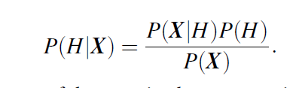
P(H), P(X|H), and P(X) may be estimated from the given data.
Bayes’ theorem provides a way of calculating the posterior probability, P(H|X), from P(H), P(X|H), and P(X)

Slide 6

Naïve Bayesian Classification
Let D be a training set of tuples and their associated class labels
Each tuple is represented by an n-dimensional attribute vector, X = (x₁, x₂, … , x_{n})
Suppose there are m classes, C₁, C₂, … , C_{m}
Given a tuple, X, the classifier will predict that X belongs to the class having the highest posterior probability, conditioned on X.

Slide 7
We maximize P(C_{i}|X).
The class C_{i} for which P(C_{i}|X) is maximized is called the maximum posteriori hypothesis.
As P(X) is constant for all classes, only P(X|C_{i})P(C_{i}) need be maximized
If the class prior probabilities are not known, the classes are equally likely, ie, P(C₁) = P(C₂) =…= P(C_{m}), and we would therefore maximize P(X|C_{i})
Notes:
P(X) is treated as a constant because the sum of probabilities for all possible evidence states must be 1.

Slide 8
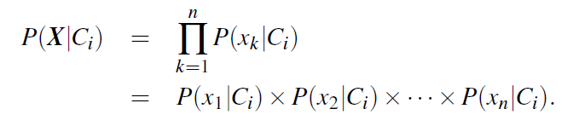
Given data sets with many attributes, it would be expensive to compute P(X|C_{i})
To reduce computation in evaluating P(X|C_{i}), the naive assumption of class conditional independence is made
If A_{k} is categorical, then P(x_{k}|C_{i}) is the number of tuples of class C_{i} in D having the value x_{k} for A_{k}, divided by |C_{i,D}|, the number of tuples of class C_{i} in D.

Slide 9
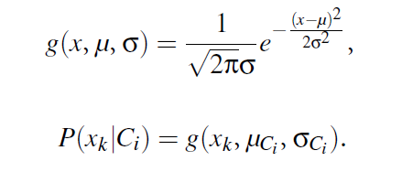
If A_{k} is continuous-valued
A continuous-valued attribute is typically assumed to have a Gaussian distribution with a mean μ and standard deviation , defined by
Compute the mean (i.e., average) and standard deviation of the values of attribute A_{k} for training tuples of class C_{i}

Slide 10

In order to predict the class label of X, P(X|C_{i})P(C_{i}) is evaluated for each class C_{i}.
The classifier predicts that the class label of tuple X is the class C_{i} if and only if
The predicted class label is the class C_{i} for which P(X|C_{i})P(C_{i}) is the maximum.
Notes:
https://www.youtube.com/watch?v=XzSlEA4ck2I

Slide 11
Example
Attributes - age, income, student, and credit rating
The class label attribute, buys computer, has two distinct values (namely, {yes, no})
C1 - class buys computer = yes
C2 - class buys computer = no
Tuple we wish to classify is
X = (age = youth, income = medium, student = yes, credit rating = fair)
Maximize P(X|C_{i})P(C_{i}), for i = 1, 2

Slide 12
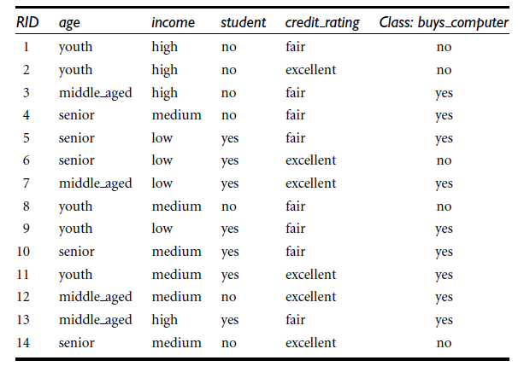

Slide 13
Compute prior probability :
P(buys_computer = yes)= 9/14= 0.64
P(buys_computer = no)= 5/14 = 0.36
2. Calculate current probability or conditional probability of individual attributes.
age | Yes | No
youth | 2/9 | 3/5
middle_aged | 4/9 | 0
Senior | 3/9 | 2/5
income | Yes | No
high | 2/9 | 2/5
medium | 4/9 | 2/5
low | 3/9 | 1/5
student | Yes | No
yes | 6/9 | 1/5
no | 3/9 | 4/5
credit _rating | Yes | No
fair | 6/9 | 2 /5
excellent | 3 /9 | 3 /5

Slide 14
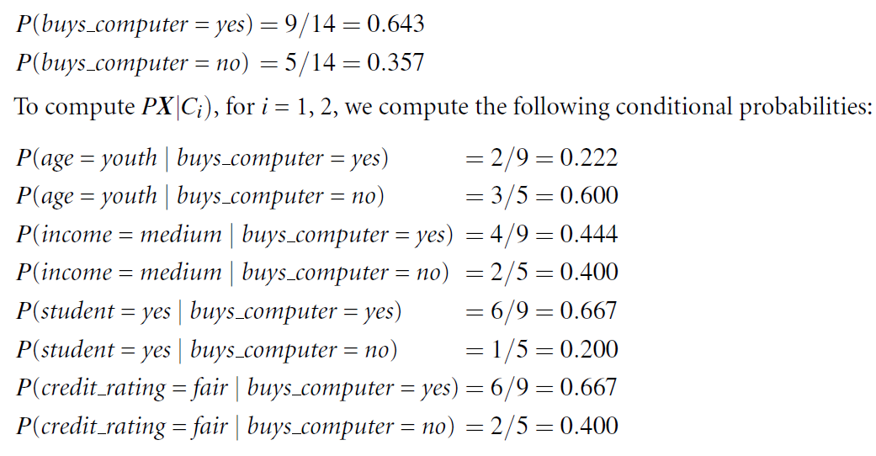
X = (age = youth, income = medium, student = yes, credit rating = fair)
To compute P(X|C_{i}), for i = 1, 2, we compute the following conditional probabilities:

Slide 15
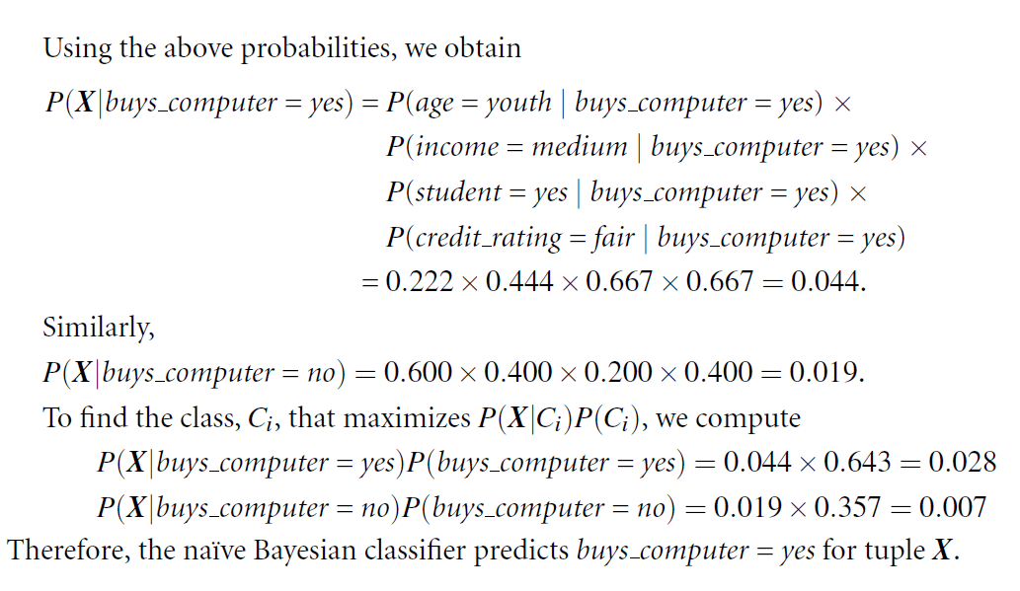

Slide 16
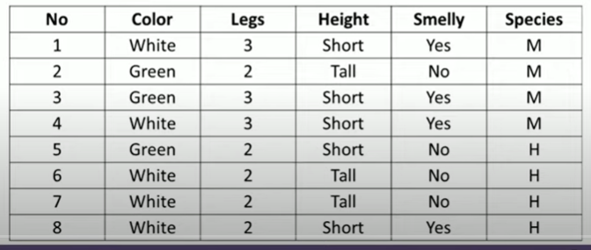
Example 2
New instance =(Color=Green, Legs=2, Height=Tall and Smelly=No)

Slide 17

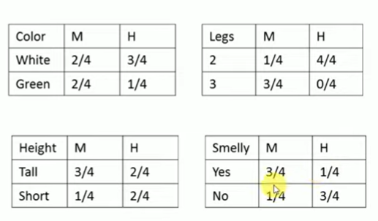
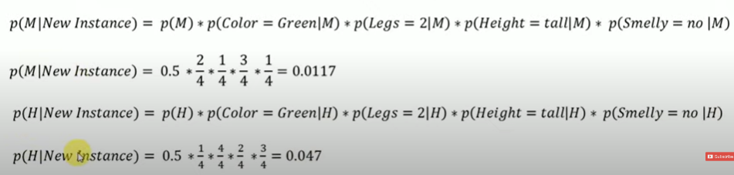

Prior Probability:
Compute the conditional probability:

Slide 18
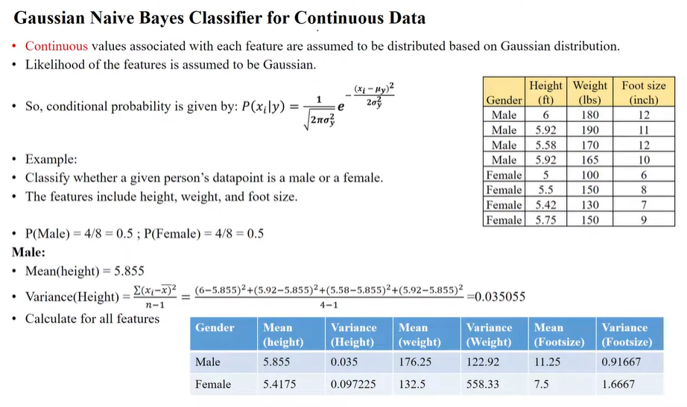

Slide 19
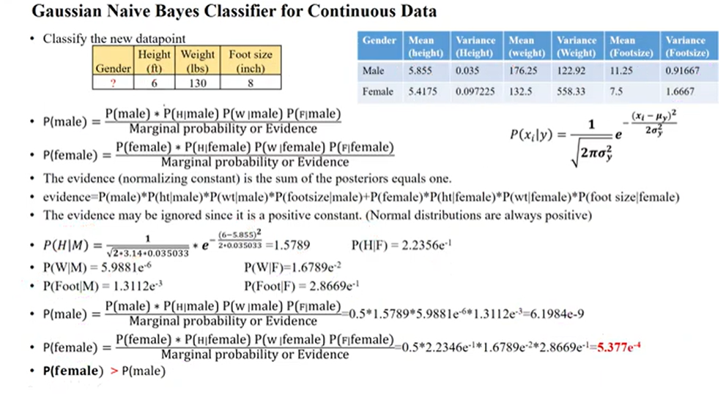
Notes:
https://www.youtube.com/watch?v=vuvox8zXvGY

